Slide 1
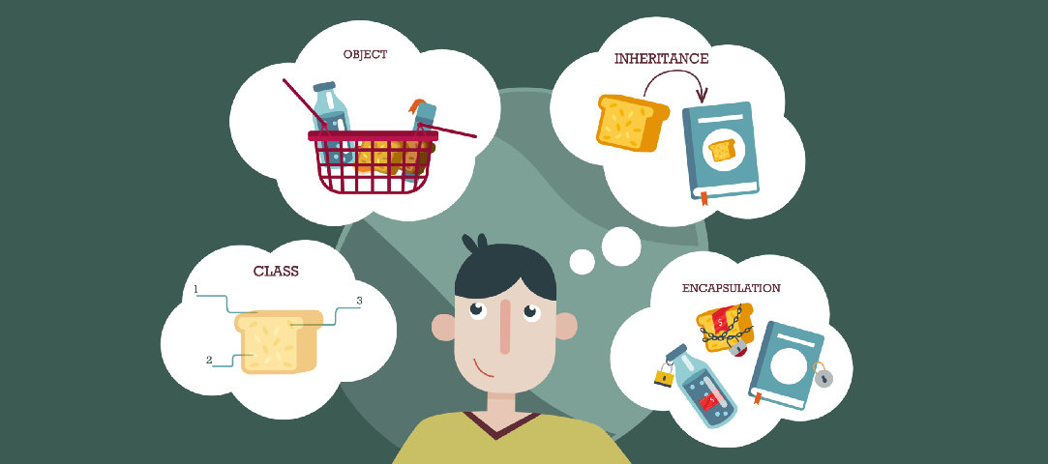
Lecture – 4 Class and Object in JAVA
Afsara Tasneem Misha
Lecturer
Department of CSE
Daffodil International University

Slide 2
Contents
Class and Object in Java
UML notations for class

Slide 3
Class and Objects

Slide 4
Classes and Objects
Classes and Objects are basic concepts of Object Oriented Programming which revolve around the real life entities.
Everything in OOP is associated with classes and objects.
A Class is like an object constructor, or a "blueprint" for creating objects.

Slide 5
1. Class
A class is a user defined blueprint or prototype from which objects are created.
It represents the set of properties or methods that are common to all objects of one type.
A java class can contains:
Data member/variables
Method
Constructor
Block of Statements
Class or Interface

Slide 6
*** Syntax of Creating a Class
modifiers class ClassName{
//body of the class
}
***Class Names - For all class names the first letter should be in Upper Case.
Example: public class Box { }
public class MyBox { }

Slide 7
2. Object
A class is a template or blueprint from which objects are created. So, an object is the instance(result) of a class.
Object Definitions:
An object is a real-world entity.
An object is a runtime entity.
The object is an entity which has state and behavior.
The object is an instance of a class.

Slide 8
***Syntax of Creating an Object
ClassName objectName = new default_Constructor();
***Object Names - For all object names the first letter should be in lower Case.

Slide 9
Example - 1
Create a Box Class. Each box of this class will have height and width.
Create one object of the Box Class and display the information.

Slide 10
Solution of Example - 1:
public class Box {
int height;
int width;
public static void main(String[] args) {
Box box1 = new Box();
box1.height = 10;
box1.width = 20;
System.out.println("\nHeight of box1 = " + box1.height);
System.out.println("Width of box1 = " + box1.width);
}
}

Slide 11
Example - 2
Create a Person Class. Each person of this class will have name and age.
Create two objects of the Person Class, Set the values and display the information.

Slide 12
UML: Unified Modeling Language UML Representation of CLASS
ClassName
Instance Variables
Methods

Slide 13
UML representation of Class from Example - 1
Box
height: int width: int
+ main(String[]) : void

Slide 14
Example – 3: Write a Java code from this UML
Student
- name: String - id: int
+ main(String[]) : void
Create two objects of the Student Class, Set the values and display the information.

Slide 15
Solution of Example - 3:
public class Student {
private String name;
private int id;
private double cgpa;
public static void main(String[] args)
{
Student std1 = new Student();
std1.name = "Abdullah";
std1.id = 100;
std1.cgpa = 3.5;
System.out.println("Name of Student -1 : "+std1.name);
System.out.println("ID of Student - 1 : "+std1.id);
System.out.println("CGPA of Student - 1: "+std1.cgpa);
Student std2 = new Student();
std2.name = "Kabir";
std2.id = 200;
std2.cgpa = 3.8;
System.out.println("\n\nName of Student -1 : "+std2.name);
System.out.println("ID of Student - 1 : "+std2.id);
System.out.println("CGPA of Student - 1: "+std2.cgpa);
}
}

Slide 16
Example – 4: Write a Java code from this UML
Department
- deptName: String - deptCode: int - faculty: String
+ main(String[]) : void
Create two objects of the Department Class, Set the values and display the information.

Slide 17

Thank you!

